Slide 1

Welcome
to
Scoil San Isadoir

Slide 2

Mission Statement
To give the children a sense of self-worth and value, to empower them to develop their individual potential as human beings and to respect all others as equals. See school website www.boherlahanns.com for full mission statement and school policies.

Slide 3
School Team
Múinteoir Catherine: Principal
Múinteoir Sharon: Deputy Principal
Múinteoir Irene: Teacher
Múinteoir Lauren: Teacher
Múinteoir Tina Teacher
Múinteoir Shauna: Teacher
Sinéad Doyle: School Secretary
Kay Fanning: SNA
Joanne Maher: SNA
Caroline Fitzgerald: Caretaker

Slide 4
Parents Council & B.O.M
Board of Management
Brendan Ryan (Chairperson)
Fr. Joe Egan (Vice Chair.)
Catherine Cleary (Secretary)
John Maher (Treasurer)
Tina O’Brien (Teacher Rep.)
Mairéad Tarrant (Parent Rep.)
Mary Ryan & J.J. Kennedy (Community Reps.)
Parents Council
Kathryn Maher (Chairperson)
Mairead Hogan & Averil Maher (Joint Secretary)
Ruth O’Conner & David Kinane (Joint Treasurers)
Committee Members – (11 Parents)

Slide 5
The School Day
Morning
  School begins at 9:20.
  Punctuality is the key.
Home Time
All junior infants go home at 2 o’clock. Prompt collection is essential as your child may fret if he/she thinks there is nobody coming.
If there are any special collection arrangements please let us know in advance by phoning the office.
  Attendance:
  Please ring the office or send
  an email if your child is sick
  and absent from school.
  Bus
  Are you eligible for the
  bus? Contact Bus Éireann
  Tel. 061 217484
  www.buseireann.ie

Slide 6
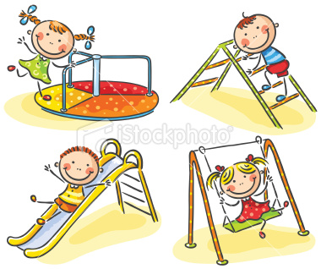
Breaks
There are two breaks during the day, a short one from 11:00am to 11:15am and a longer break from 1.00pm to 1:25pm.
An area of the playground is reserved especially for junior and senior infants.
All children go outside except during inclement weather.
Additional time for eating lunch is given before break begins.
Children who are unable to go outside need an explanatory note from their parent/guardian.

Slide 7




Lunches
We have a “healthy eating” policy in our school. This is fully supported by the parents.
Consider the amount of food you give your child for lunch.
We try to ensure that the children eat a good portion of their lunch by allowing them time to eat before going out.
Please ensure that your child’s lunch box is clearly labelled with his/her name.
Only healthy drinks with screw-on caps or reusable bottles are allowed. No straws and no plastic wrapping on lunches, in keeping with our Green Schools policy.

Slide 8

Uniform
Pupils must wear their school uniform which is a crested jumper/cardigan, navy pinafore/skirt/trousers and blue shirt/blouse or they can wear plain navy tracksuit bottoms, blue polo t-shirt and their crested jumper. Teachers will tell students which days are tracksuit days and which days are full uniform days in September.Crest are available for purchase for €4.50 from the school office.
Please label your child’s clothes, especially jumpers, cardigans, tracksuit tops and coats.
In very cold weather make sure your child has extra clothes under their uniforms e.g. T-shirt or vest. Make sure your child brings a warm coat and hat in cold weather and a rain jacket in milder weather. A spare coat can be left in the cloakroom for days where they forget their coat.
Please get your child waterproof runners/shoes/boots as the astro pitch can get wet during the winter and the children will be on it. Spare socks can be left in their bag also.

Slide 9
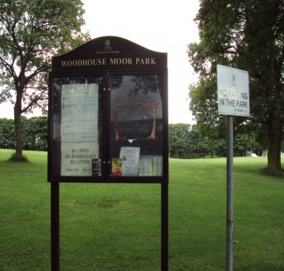

Home School Communications
Please keep an eye on your child’s folder as they may contain notes for parents.
An email or phone call to the office is required to explain your child’s absence from school, while they are out.
Email: It is essential to have your up to date email address
Text a Parent Service. It is essential to inform the school if there is a change in phone number.
School Website www.boherlahanns.com
Please don’t hesitate to arrange a meeting with the Junior Infant teacher if you feel anxious about your child.
Formal written reports are sent out at the end of the Summer term.
Keep an eye on the noticeboard at the front of the school

Slide 10



Health and Safety
If your child has an allergy, medical condition problem with sight or hearing, or is being assessed by a health professional or has any specific needs, please make sure that the school is informed.
If you have any medical reports on your child, which may have an impact on their ability to learn, please share it with the school.
We wish to care for him/her to the best of our ability.
During the year you will receive information from the HSE about: the Junior Infant vaccination programme
Sight & hearing tests

Slide 11

Child Safeguarding
As the parent of a child in Scoil San Isadóir, it is important that you are aware that there are child safeguarding measures in place, such as all school staff training, Garda vetting for all school staff and adult volunteers, record keeping including signing in/out procedures, to ensure your child’s safety.
Please be reassured that the school takes the area of child protection seriously as it is extremely important. The Designated Liaison Person is the school principal Catherine Cleary and the Deputy DLP is Deputy Principal Sharon McCullagh

Slide 12

First day - a happy one !
Be sure to arrive on time.
When you arrive, be as casual as you can. If you are relaxed, your child will be more relaxed.
Hopefully your child will be absorbed in the new surroundings. Having given assurance to your child that you will be back to collect them, wave goodbye at the gate and make your getaway without delay.
Their teacher will be in the yard to keep an eye on him/her and when the bell rings they will go into the classroom. This may take a little time, all children are different.
For the first two weeks the children will be going home at 12noon.

Slide 13




Going home
Be sure to collect your child on time. Children can become very upset if they feel they are forgotten.
If you cannot collect your child on a particular day, tell them who you have organised to collect them that afternoon so that they don’t get upset.
Emergencies happen
If at any time the collecting routine is changed unexpectedly, contact the school, a phone call can ease anxiety.

Slide 14
Toys
There is no need for children to bring toys into school, we do not encourage this practice because of breakages, loss, competition and peer pressure.
We have an extensive range of fun, attractive, educational games and activities in the classroom. Learning through play, the Aistear programme is implemented in the school.

Slide 15


Help your child to learn at home
Language: speaking, listening, nursery rhymes, imaginative play.
Play with them
Feeling and Emotions:
  There are some very good ideas in the booklet to help with this whole area.
Getting ready to read
Getting ready to write
Understanding Maths
Postpone the use of electronic devices until your child is much older

Slide 16

Reading
Phonological awareness and phonics
Fun approach
Use of story
Use of actions
Shared Reading
Reading aloud to your child will cultivate an interest in, and love of reading.
Free membership in Cashel Library for children and access to a wide variety of books.

Slide 17



Writing
Developing fine motor skills:
These skills need to be developed before the child comes to school, before bad habits embedded. There are numerous ideas and advice in the booklet to guide parents in this regard.
Pencil Grip:
It is vital that a child’s pencil grip is correct from a very early stage. This needs to be monitored on an ongoing basis.
Your child will be learning to write lower case letters in Junior Infants.
Avoid using capitals where not appropriate especially in your child’s name.

Slide 18
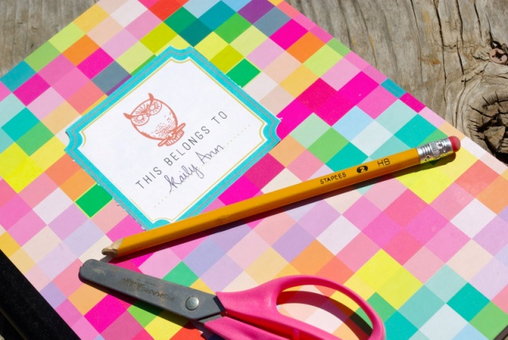
Booklist & Stationery
Your child’s books and copies will be purchased
by the school under new Department rules.
Parents will need to purchase the following:
  2 x Jumbo grip pencils
  2 x plain white rubbers
  one pack of 12 twistable crayons
  one soft zipped folder
  1 x 40g glue stick
  Please ensure that all stationery is
  clearly labelled.

Slide 19


Mol an óige agus tiocfaidh sí!
We’ll see you on Wednesday 30th August 2023.

